Slide 1
EMPLOYEE DATA ANALYSIS USING EXCEL
NAME
RANJANI B
REGISTER
NO
312206334
DEPART MENT
B.COM (ACCOUNTING & FINANCE)
COLLEGE
SSKV COLLEGE OF ARTS & SICENCE FOR WOMEN

Slide 2
PROJECT TITLE
EMPLOYEMENT PERFORMANCE ANALYSIS USING EXECL

Slide 3
AGENDA
• Problem statement
• Project overview
• End users
• Our solution and proposition
• Dataset description
• Modelling approach
• Results and discussion
• conclusion

Slide 4
PROJECT STATEMENT
• Track employee performance rating overtime
• Identify top performers and underperformers
• Analyse performance by department, job role, and other categories
• Visualize trends and correlations in performs data
• Enable filtering and drill-down capabilities for in-depth analysis

Slide 5
PROJECT OVERVIEW
•Effective employee performance management is crucial for organization to achieve their goals and objectives.
• This project will involve collecting and cleaning employee performance data, designing and developing an interactive Excel dashboard, and creating a user guide and data dictionary for easy adoption.

Slide 6

WHO ARE THE END USERS ?
Department heads
Team leads
Line managers
Talent management
Business analysts
Executives
HR Manager

Slide 7

OUR SOLUTION AND ITS VALUE PROPOSITION
Conditional formation – mission
Filter – remove
Formula – performance
Pivot – summary
Graph – data visualization

Slide 8
FILITER – REMOVE: By incorporating filtering and removal capabilities ,our solution empowers HR managers and leaders to efficiently analyse and visualise employee performance data, driving informed decision – making and Business Success.
FORMULA _ PERFORMANCE: By leveraging formulas and performs metrics in Excel, in our solution provides a powerful and efficient tool for employee performance analysis enabling HR managers and leaders to make informed decision and drive business success.

Slide 9
PIVOT – SUMMARY: By leveraging pivot tables land summary reports in Excel, our solution provides a powerful and flexible tool for employee performance analysis, enabling HR managers and leaders to make informed decisions and drive business success.
GRAPH – DATA VISUALIZATION: By leveraging graphs and data visualization in excel our solution provides a power and intuitive tool for employee performance analysis , enabling HR managers and leaders to make informed decision and drive business success.

Slide 10

DATASET DESCRIPTION
Employee= kaggle
26-features
9-features
Emp id-Num
Name-text
Name-text
Emp type
Performance level
Gender – male female
Employee rating-Num

Slide 11

THE “WOW” IN OUR SOLUTION
Performance level: =IFS(Z4>=5,”VERY HIGH:,Z4>=4,
“HIGH”,Z4>=3,”MED”,TRUE,”Low”)

Slide 12
MODELLING
DATA COLLECTION
kanngale
search employment performance dataset
then download employment dataset.
FEATURE COLLECTION
Features identify
colour filled blank values
DATA CLEANING
Missing values identify
Missing values filter out

Slide 13
MODELLING
PERFORMANCE LEVEL:
calculate performance level
using formula
Summary
open pivot table
drag rows ,columns , filters, values respectively business unit,
performance level, gender code, count of first name.
remove the blank option.
VISULAZATION
Put recommended graph
filter out the linear and exponential features
To get pie chart for our reference.

Slide 14
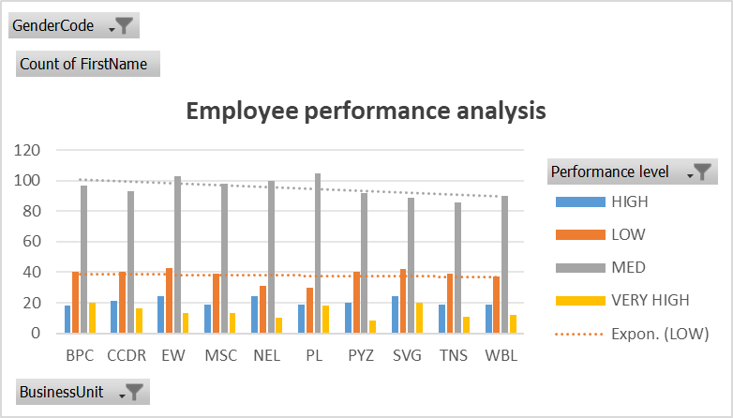

Slide 15
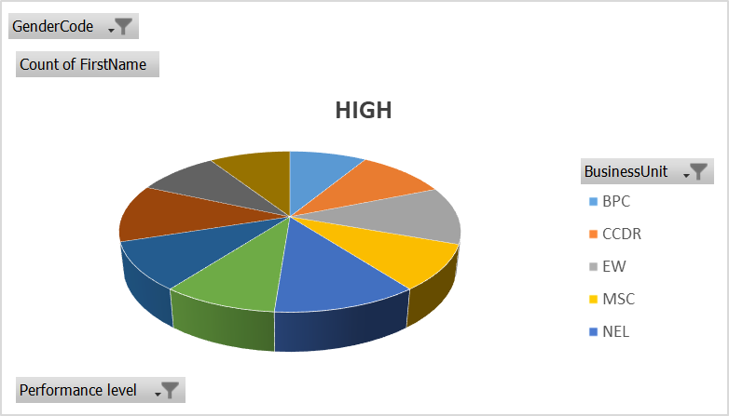

Slide 16
CONCLUSION
Analysing the employment performance dataset provides valuable insights into employee productivity , efficiency, and overall contribution to organised goals.
Graphs play a crucial role in visualizing the data and useful for comparing individual employee performance.

